Slide 1

Lambda Landfills Trash Haulers Missed Pickups Analysis
Notes:
We are excited to share our group’s analysis of Missed Trash Pickups in Metro Nashville, using service request data from hubNashville, the city’s customer service system. Our goal was to calculate potential fines and highlight key patterns in this real-world dataset.

Slide 2
Objective
As part of Metro's contract with Red River Waste Solutions, failure to remedy an action or inaction will result in liquidated damages. One category of liquidated damages is related to chronic problems in any category of service at the same premises. A chronic problem is defined as more than one missed pickup for any address. The first missed pickup will not result in a fine; however, every subsequent missed pickup will result in a $200 fine.
Determine the total amount of damages due to missed pickups.
Notes:
Our assignment was to: Identify all missed trash pickups from the raw service request data and clean and prepare the data so only true missed pickups were counted.
We made sure to apply Metro’s contract rule: the first missed pickup at an address is free, but every additional missed pickup costs $200. Following these steps allowed our team to estimate the total damages owed by each hauler.

Slide 3
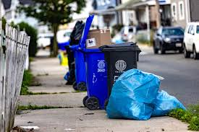
Total unique addresses with missed pickups: 12,647 Total damages owed: $942,800.00 Addresses with no fines (first offense): 9,938 Addresses with fines: 2,709 Fine Distribution: $200: 1,738 addresses $400: 534 addresses $600: 218 addresses $800: 86 addresses $1,000: 55 addresses $1,200: 23 addresses $1,400: 24 addresses $1,600: 12 addresses $1,800: 4 addresses $2,000: 5 addresses $2,200: 2 addresses $2,400: 1 addresses $2,800: 1 addresses $3,000: 1 addresses $3,200: 2 addresses $3,400: 2 addresses $3,600: 1 addresses
Total Damages Calculations
Notes:
Before any calculations, we worked together to explore and clean the dataset. We removed unrelated service requests and standardized addresses to ensure accuracy. This preparation step was critical so that only valid missed trash pickup records remained.
After cleaning, we found:
12,647 unique addresses with at least one missed pickup.
2,709 addresses had multiple misses and were subject to fines.
The total damages owed are approximately $942,800.
This shows how fines are distributed. Most fined addresses owe $200 for a single repeat miss, but a few chronic problem addresses accumulated fines of $1,000 to over $3,000.

Slide 4
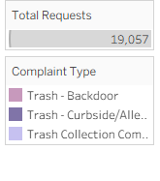
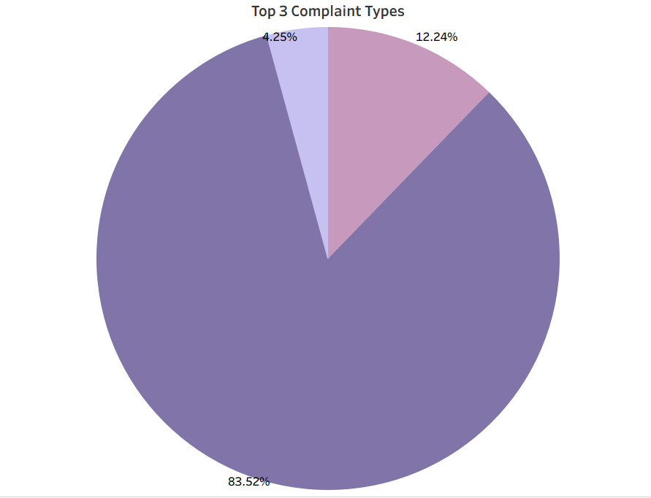
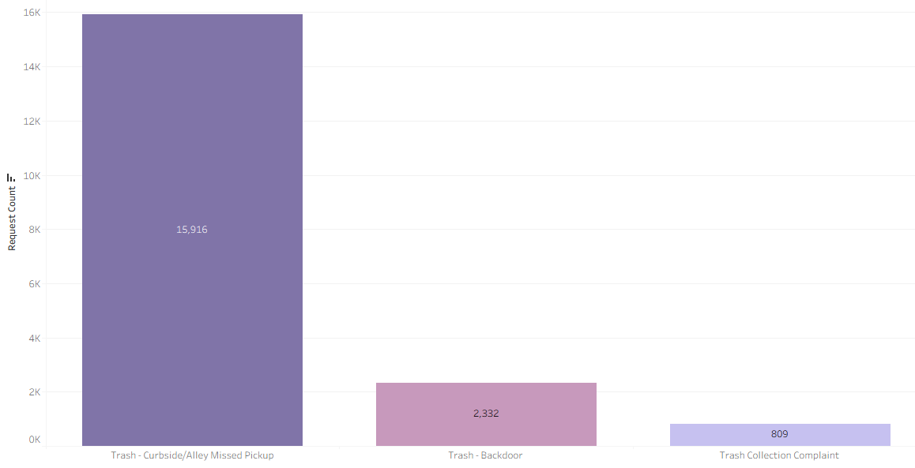
Complaint Distribution
Complaint Type (Request) Number of Complaints
Trash - Curbside/Alley Missed Pickup 15916
Trash - Backdoor 2332
Trash Collection Complaint 809
Notes:
The hubNashville system also tracks other complaints. Even after filtering, we found categories such as backdoor service issues and general collection complaints, but missed pickups dominate with over 15,900 curbside or alley requests.

Slide 5
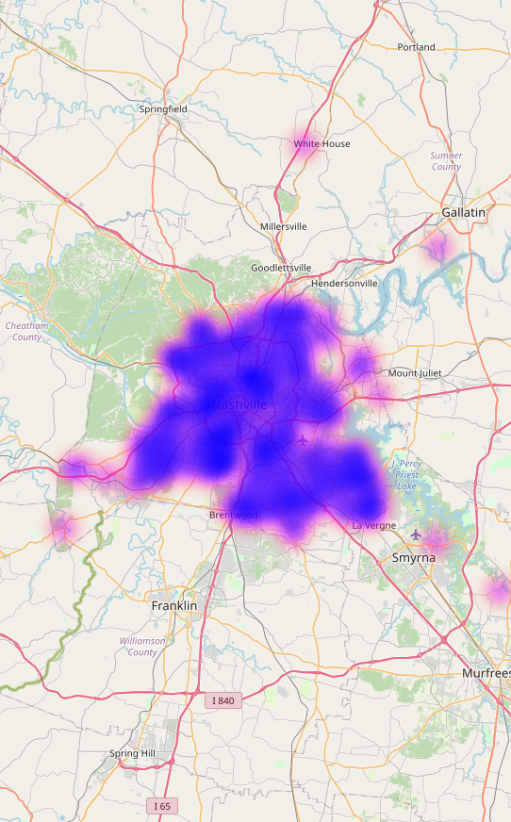
Top 10 Zip Codes by Total Missed Pickups
Zip Code | Total Fines | Missed Pickups | Total Requests
37013 | $108,600 | 1,511 | 2,278
37211 | $108,000 | 1,445 | 2,248
37215 | $78,800 | 876 | 1,404
37209 | $65,200 | 857 | 1,411
37206 | $43,000 | 835 | 1,217
37205 | $80,800 | 820 | 1,491
37207 | $56,600 | 781 | 1,300
37115 | $68,600 | 719 | 1,266
37214 | $37,400 | 676 | 1,004
37208 | $49,400 | 639 | 1,039
Notes:
For this part of the project, our team built two separate heat maps to better understand the geographic patterns in the data.
The first heat map shows total missed pickups by zip code. This map highlights where service requests for missed trash collection are concentrated. Large clusters appear in several neighborhoods, with a particularly strong hotspot in zip code 37013, which stands out well above the rest. These areas represent the highest service demand and reveal where residents experience the most disruption.

Slide 6
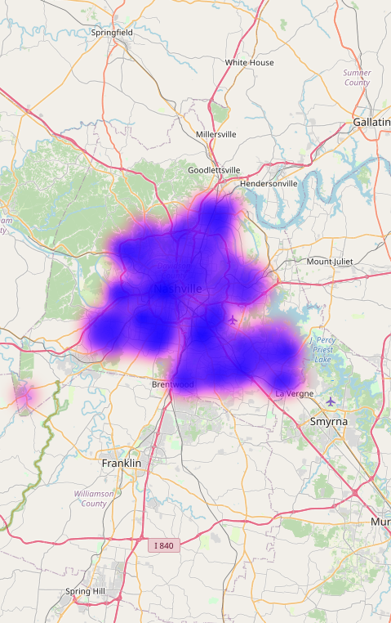
Total Fines by Zip
Zip Code | Total Fines | Missed Pickups
37013 | 108600 | 1511
37211 | 108000 | 1445
37215 | 78800 | 876
37209 | 65200 | 857
37206 | 43000 | 835
37205 | 80800 | 820
37207 | 56600 | 781
37115 | 68600 | 719
37214 | 37400 | 676
37208 | 49400 | 639
37218 | 48000 | 619
37216 | 29200 | 556
37217 | 38200 | 531
37204 | 30600 | 403
37212 | 22600 | 381
37210 | 27400 | 325
37203 | 22000 | 221
37220 | 14400 | 184
37027 | 7400 | 107
Notes:
The second heat map displays total fines by zip code. Because fines are only issued after the first missed pickup at an address, this map reflects repeat service failures rather than just isolated incidents. We noticed that many of the same high-pickup zip codes also rank high in fines, but some zips with fewer total requests still appear bright because they have a higher proportion of repeat offenders.
By comparing these two maps side-by-side, we can see the difference between sheer volume of complaints and severity of chronic issues. This distinction is important for planning: Metro may need different strategies—such as education, enforcement, or contractor oversight—depending on whether a neighborhood suffers from frequent one-off misses or persistent repeat problems.

Slide 7
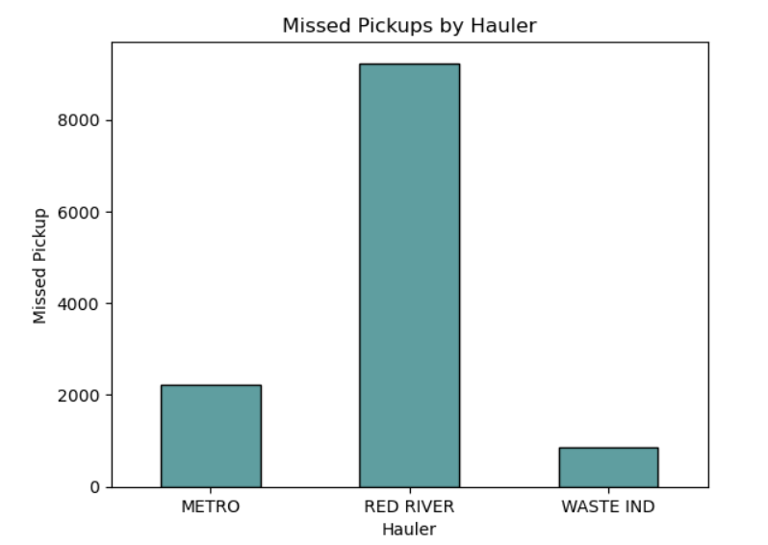
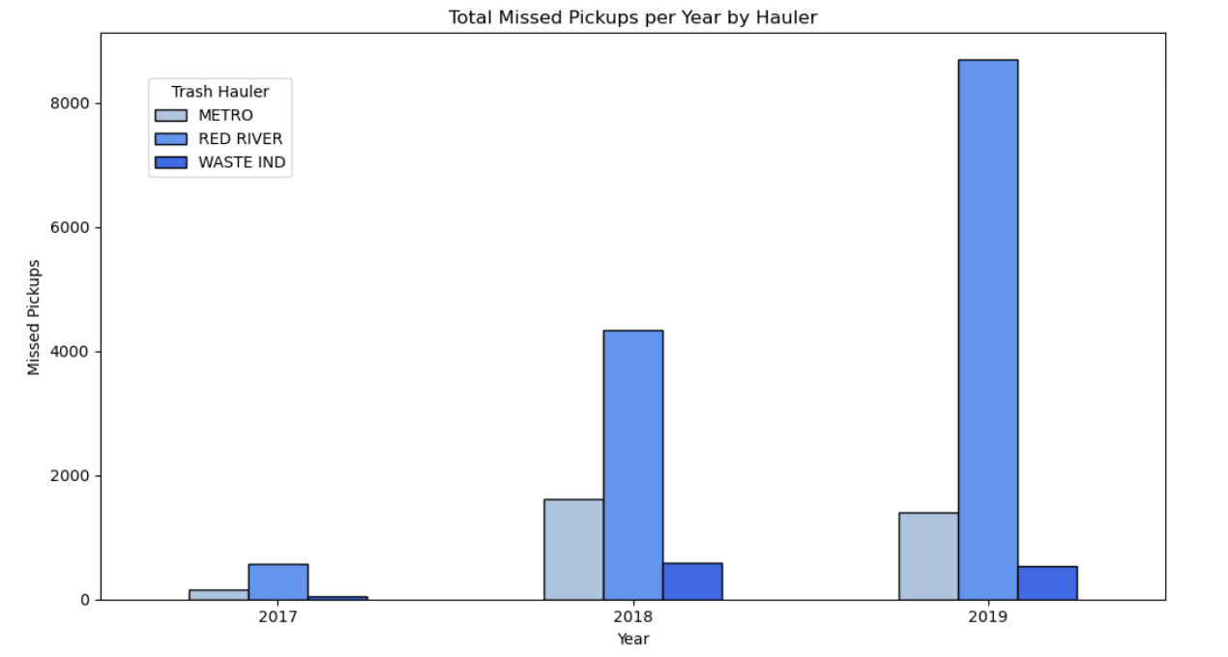
METRO vs CONTRACTORS COMPARISON
Trash Hauler | Total Req | Total Fines | Missed Pickups
METRO | 3,580 | $158,200 | 2,231
RED RIVER | 14,395 | $722,400 | 9,227
WASTE IND | 1,350 | $53,800 | 859
Notes:
We compared Metro crews to private contractors:
Red River handled the most requests and had the highest fines.
Metro crews had slightly lower missed pickups per address and a lower fine rate.
Waste Industries performed best overall with the lowest fines per request.

Slide 8
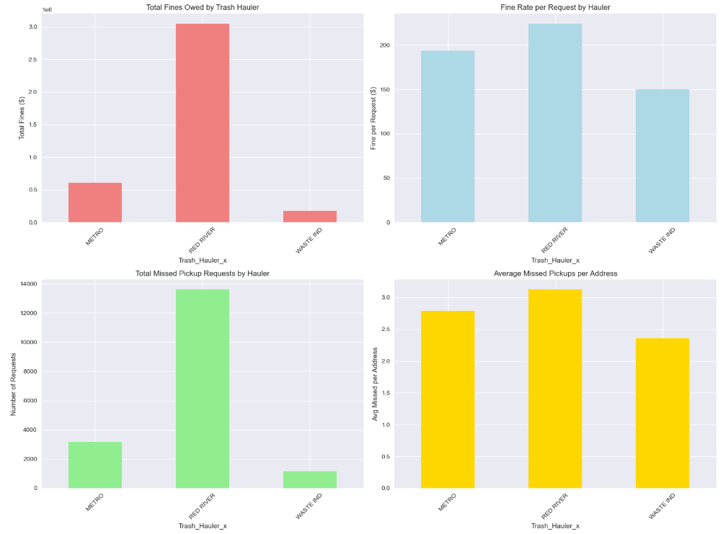
Missed pickups remain consistently high across all hauler categories
Peak performance shows 3+ missed pickups per address
Even best-performing category exceeds 2 missed pickups
Service reliability remains a key challenge across the market
Hauler performance varies significantly across service providers
Mid-tier hauler shows highest fine rates, indicating potential service quality issues
Best and worst performers have ~100 point spread in fine rates
Hauler Performance Comparison
Notes:
For this slide, our team compared service performance across the three haulers using two key metrics.
On the left chart, we show the fine rate per request. This reflects the average dollars of fines assessed for each service request. You can see a wide spread of almost 100 dollars between the best and worst performers. Red River stands out with the highest fine rate, suggesting more frequent repeat misses and potential service quality issues. Metro crews fall in the middle, while Waste Industries performs the best with the lowest fine rate.
On the right chart, we look at the average number of missed pickups per address. Again, Red River has the highest average—over three missed pickups per address, while Metro averages about 2.8, and Waste Industries is the lowest but still above 2.
These two views together show that service reliability remains a challenge across all haulers, but Red River consistently performs the worst on both measures, highlighting where Metro might prioritize oversight and enforcement.

Slide 9
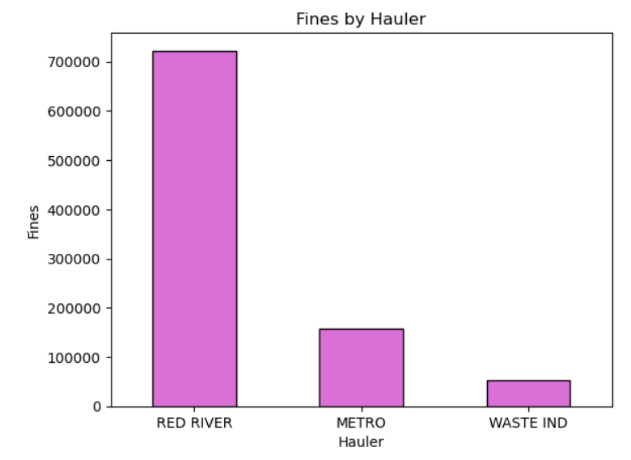

How much does each trash hauler owe?
METRO: $158,200 owed, 2,231 requests, $70.90 per request
RED RIVER: $722,400 owed, 9,227 requests, $78.29 per request
WASTE IND: $53,800 owed, 859 requests, $62.63 per request
Notes:
Breaking down total damages:
Metro owes about $158,200.
Red River owes roughly $722,400—by far the highest.
Waste Industries owes around $53,800.

Slide 10
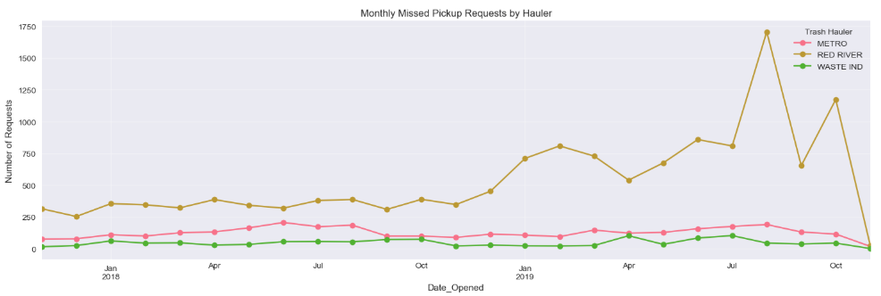
Total missed pickups by route
Top 10 Routes by Total Missed Pickups
Trash Hauler Route Requests Fines # of Unique Addresses
RED RIVER 4504 351 $129600 219
3302 320 $78800 189
4404 264 $55200 181
1303 263 $101600 138
3203 261 $79000 154
1301 257 $57800 159
METRO 9303 255 $84000 152
RED RIVER 3305 251 $63600 154
4304 246 $66800 153
3201 243 $68000 155
Worst 10 Routes by Fine per Request
Trash Hauler Route Requests Fines per Request
RED RIVER 1504S 7 $1200.00
3305S 12 $733.33
4201 106 $650.94
2303 182 $630.77
3314 133 $518.80
4510 180 $517.78
3411 7 $514.29
4302 164 $458.54
METRO 9506 68 $423.53
9208 219 $409.13
Notes:
We also examined missed pickups by route. The worst performing route was Red River Route 4504 with 351 requests and fines exceeding $129,000.
Looking at fines per request, some Red River routes averaged more than $700 per request, indicating repeated failures at the same addresses.

Slide 11
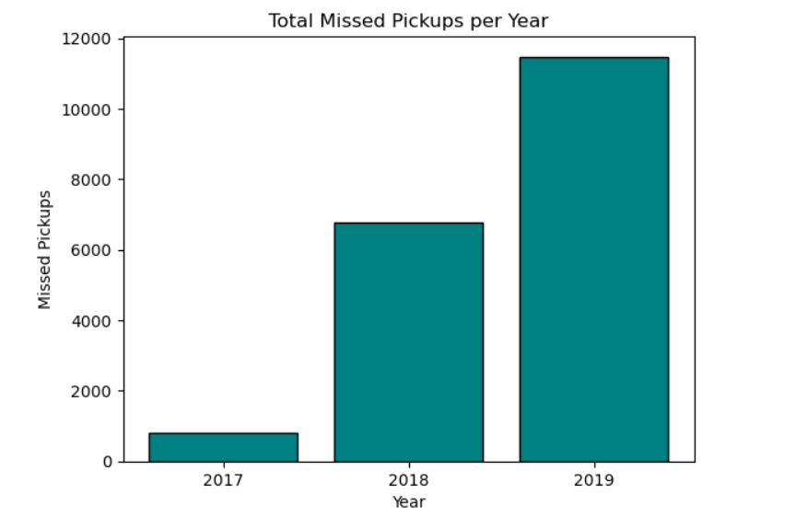
Missed by Year
2017 – 792 missed pickups
2018 – 6,786 missed pickups
2019 – 11,479 missed pickups
Notes:
Missed pickups increased dramatically:
2017: 792
2018: 6,786
2019: 11,479 This trend highlights the growing service issues over the three-year period.

Slide 12

Executive Summary
📊 OVERALL STATISTICS:
• Total service requests analyzed: 19,057
• Missed pickup requests: 17,736
• Unique addresses affected: 12,647
• Date range: November 2017 to November 2019
💰 FINANCIAL IMPACT:
• Total damages owed: $942,800.00
• Addresses subject to fines: 2,709
• Average fine per penalized address: $348.03
🚛 HAULER PERFORMANCE:
• METRO: $158,000 owed, 2,231 requests, $70.90 per request
• RED RIVER: $722,400 owed, 9,227 requests, $78.90 per request
• WASTE IND: $53,800 owed, 859 requests, $62.63 per request
📍 GEOGRAPHIC INSIGHTS:
• Highest impact zip code: 37013.0 (2,242.0 requests, $108600 fines)
• Most problematic route: RED RIVER Route 4504 (351.0 requests)
🎯 KEY RECOMMENDATIONS:
1. Focus improvement efforts on zip code 37013.0 and similar high-impact areas
2. Investigate Route 4504 operations for RED RIVER
3. Implement targeted interventions for addresses with multiple violations
4. Monitor contractor performance against Metro baseline
Notes:
To summarize our findings:
We analyzed 19,057 service requests from 2017–2019.
$942,800 in damages are owed under the contract.
Zip code 37013 and Red River Route 4504 are key problem areas.
As a team, we recommend:
Target enforcement and service improvements in high-impact zip codes.
Audit Red River operations, especially Route 4504.
Monitor addresses with chronic violations.
Continue to benchmark contractor performance against Metro crews.

Slide 13
Thank you

